Slide 1

Predictive and Prescriptive Data Analytics for Credit Unions Keys to the Future Growth
Carlos Diaz
Data Analyst

Slide 2
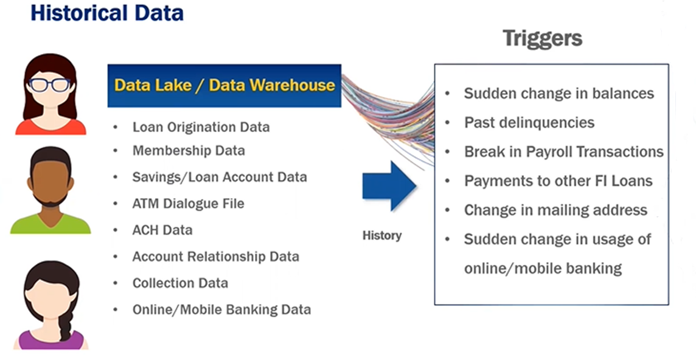

Slide 3
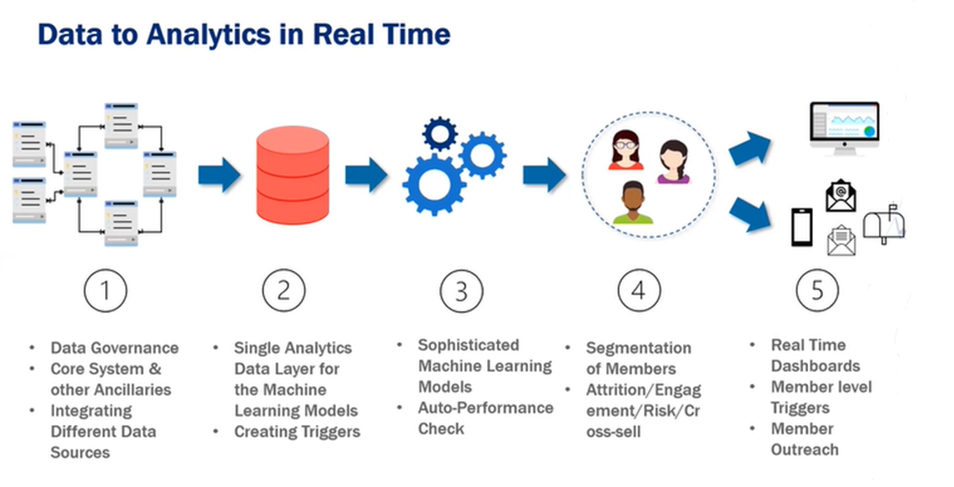

Slide 4
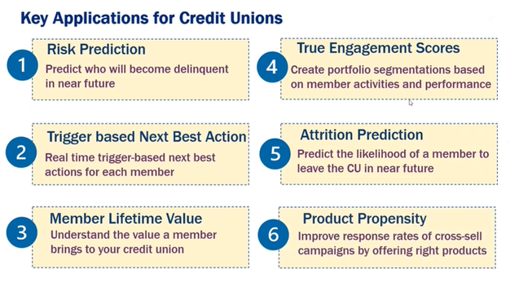

Slide 5
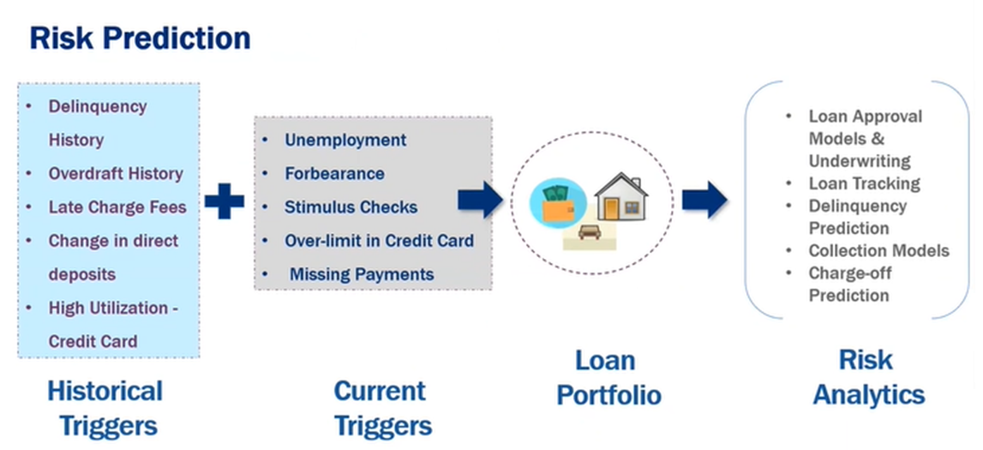

Slide 6
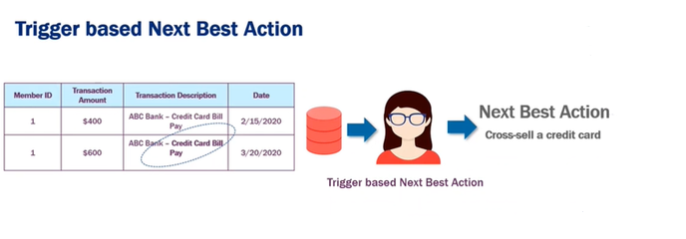

Slide 7
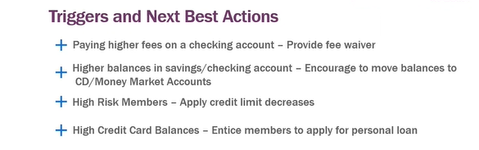

Slide 8
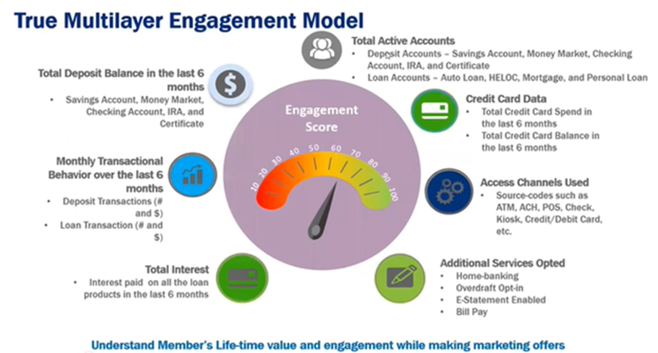

Slide 9
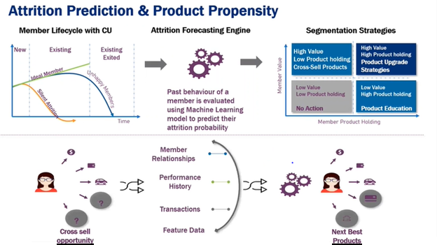

Slide 10
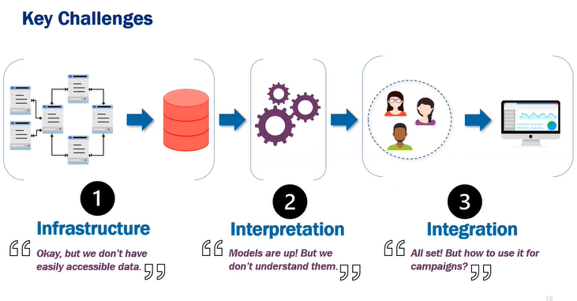

Slide 11
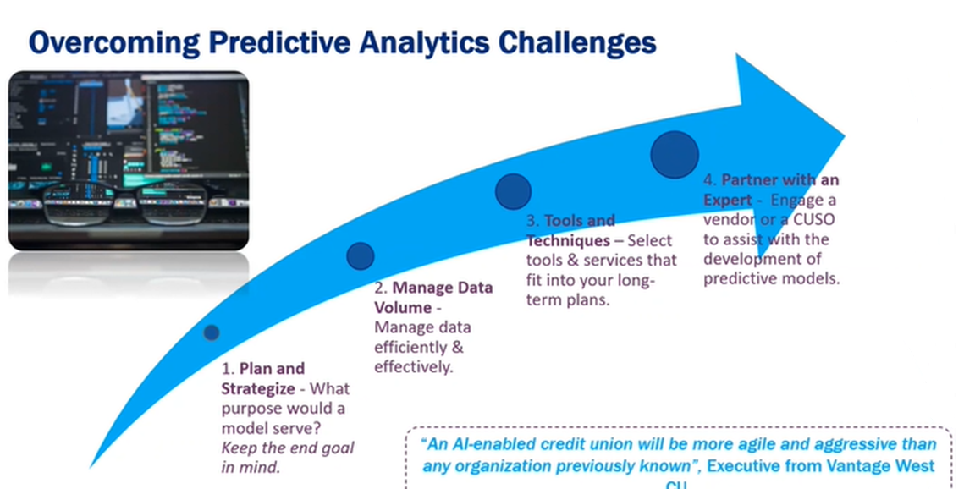

Slide 12
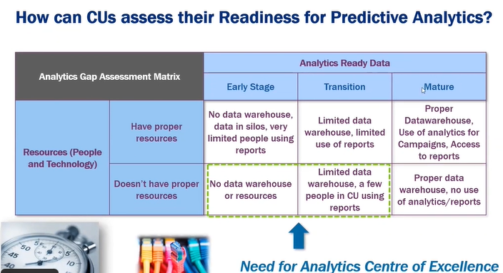

Slide 13

Machine learning
23 Ways Banks and Credit Unions Can Apply Machine Learning Today

Slide 14
Improved Marketing and Cross-Selling
Machine
Learning
Personalized recommendations and improves cross-selling and up-selling opportunities
Sharpens sales prediction.
Efficient than automated A/B testing
Churn analysis and prediction
Makes dynamic pricing possible

Slide 15

Automating Chatbot Conversations
ML can also be used to boost customer service within the banking industry, with the rise of chatbots and conversational interfaces.

Slide 16
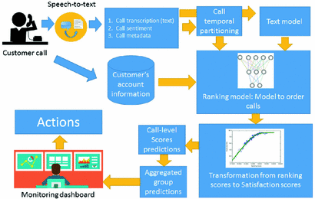
Predicting Reasons for Customers’ Calls
Best /Priority Treatment to customers that represent maximum value to the business
Avoid waiting time for valuable customers or customers who are calling again for the same issue.
Predict Treatment prior to answering the call to customers by agents.

Slide 17
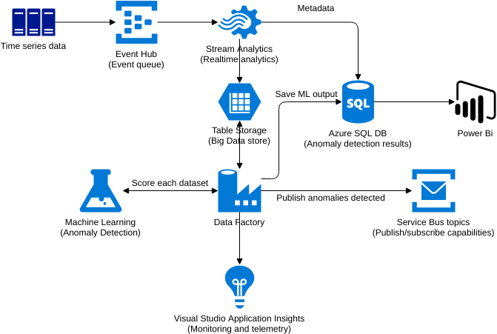
Detecting Fraud
ML deploys a machine learning model and an example dataset of credit card transactions to train the model to recognize fraud patterns. The model is self-learning which enables it to adapt to new, unknown fraud patterns.

Slide 18
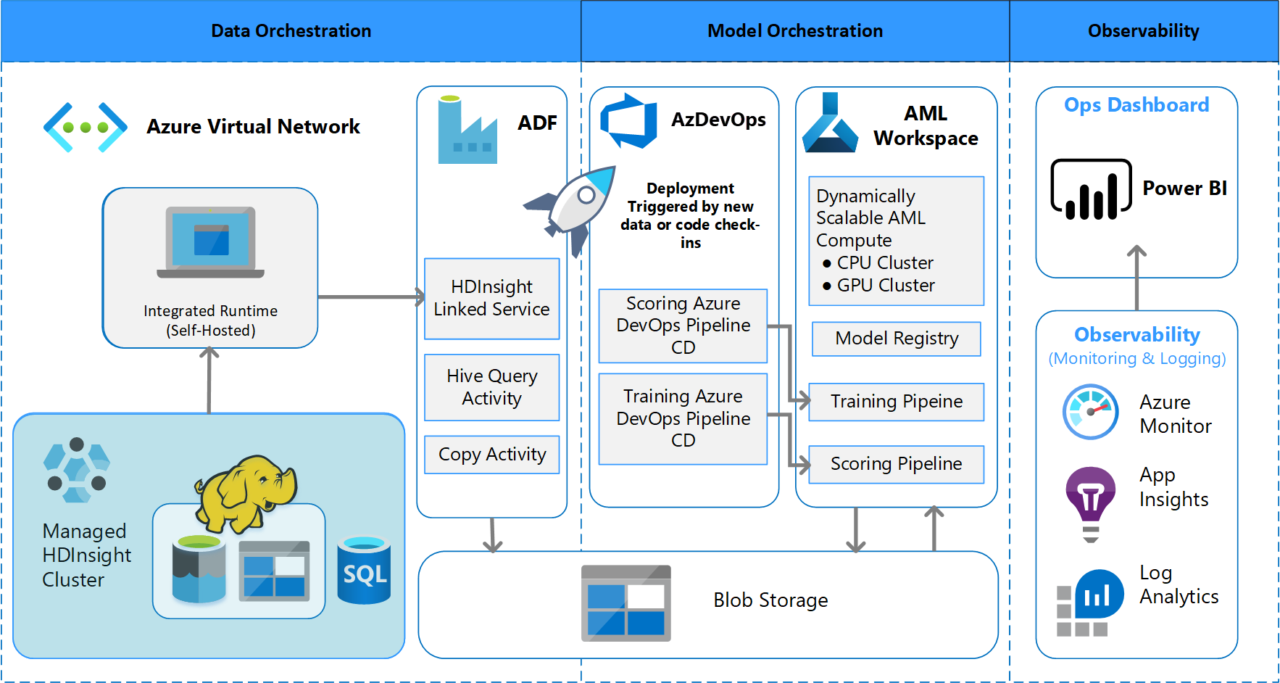
Improving Collections
ML can help this issue by predicting which borrowers that go into arrears can resolve their issues without contact and support from the credit company. Not only will this improve the customer experience, it will also have an impact on reducing the cost and time of collections teams.

Slide 19
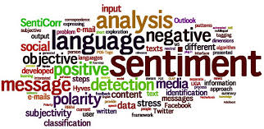
Sentiment analysis
Sentiment Analysis is the process of ‘computationally’ determining whether a piece of writing is positive, negative or neutral. It’s also known as opinion mining, deriving the opinion or attitude of a speaker.

Slide 20
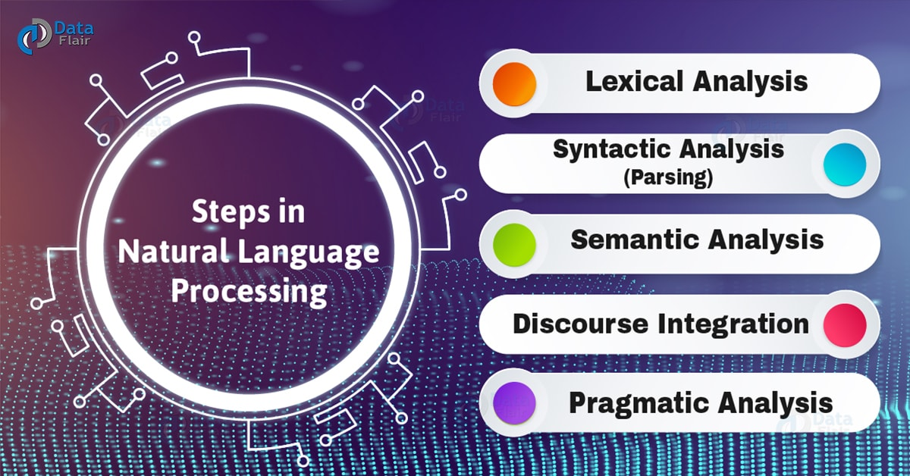
Natural Language Processing (NLP)
Automatic manipulation of natural language, like speech and text, by software.

Slide 21
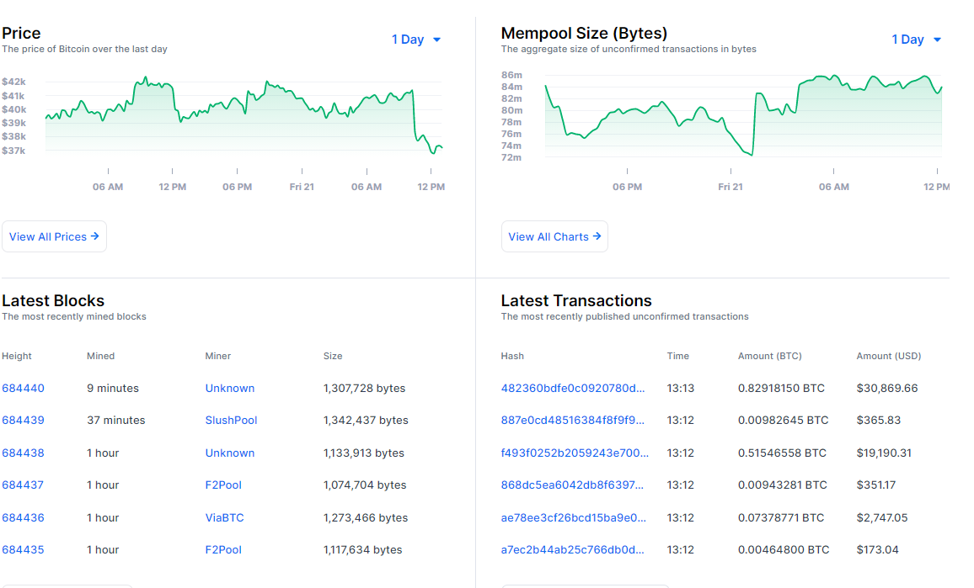
Crypto currency – Bitcoin - Blockchain
Blockchain information for Bitcoin (BTC) including historical prices, the most recently mined blocks, the mempool size of unconfirmed transactions, and data for the latest transactions.

Slide 22
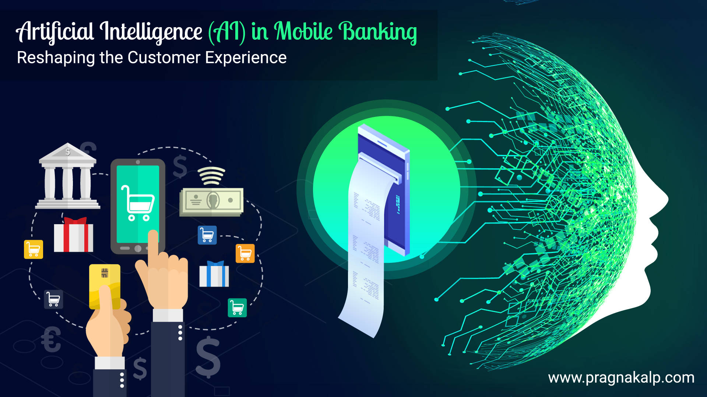
Artificial intelligence
(AI) refers to the simulation of human intelligence in machines that are programmed to think like humans and mimic their actions. The term may also be applied to any machine that exhibits traits associated with a human mind such as learning and problem-solving.

Slide 23

Cybersecurity analysis
Cyber data analysts often work to identify potential weaknesses or vulnerabilities in networks or endpoints, either from an offensive or defensive perspective. An analyst should understand common vulnerabilities, the threats that they pose and ways to manage these risks.

Slide 24
Q & A

